Slide 1
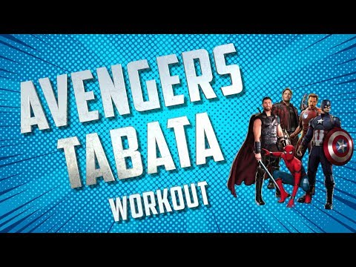

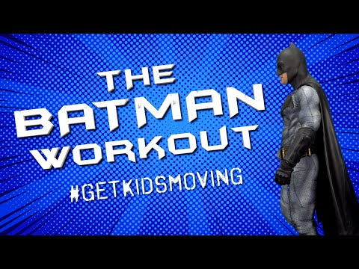


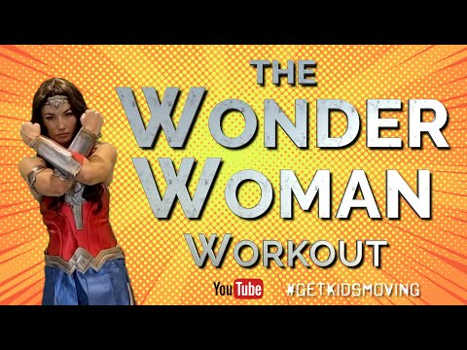

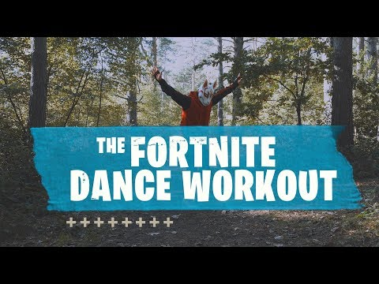
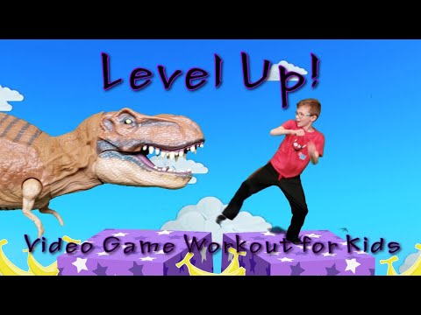
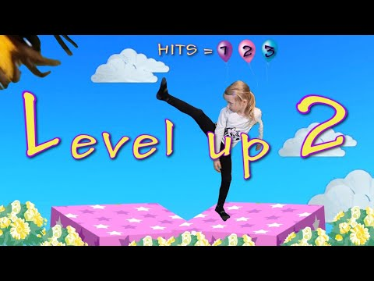
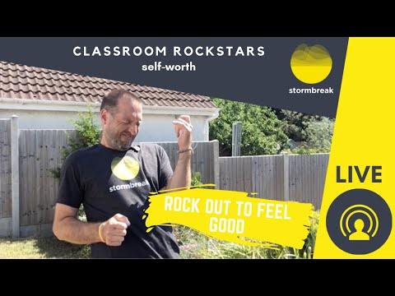
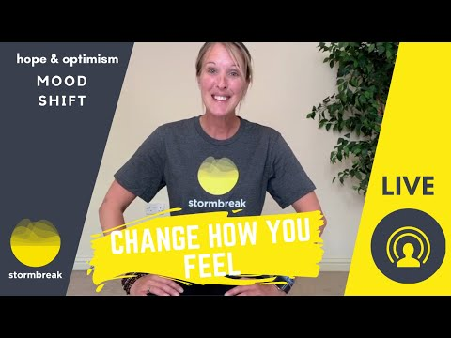
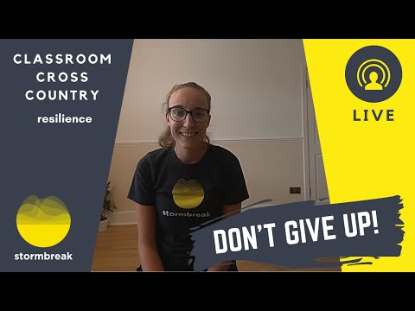
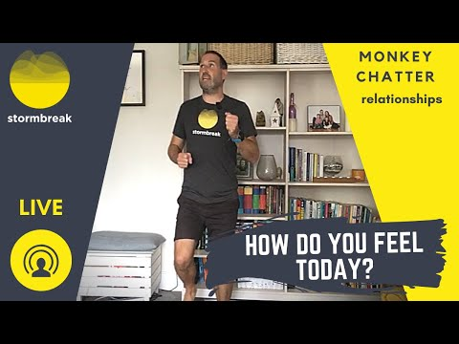
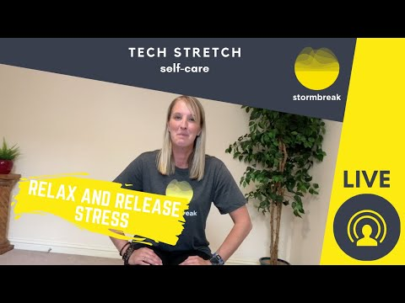
NETFLEX
Daily physical activity is very important to help keep a healthy mind and body during this difficult
time. Click on an image below to try a workout.
Healthy body = healthy mind
Themed Workouts
Stormbreak Mindfulness
Self-Worth
Hope and Optimism
Resilience
Relationships
Self-Care

Slide 2
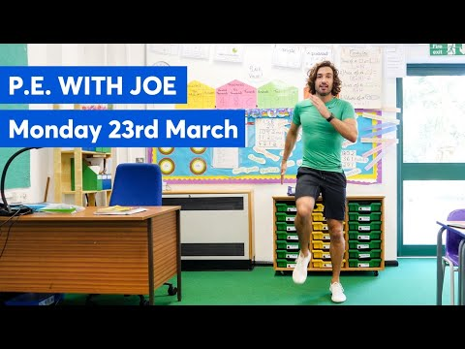
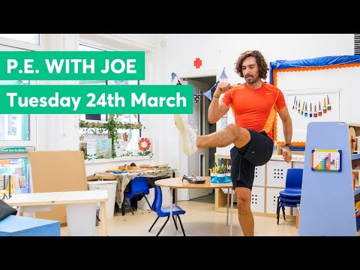
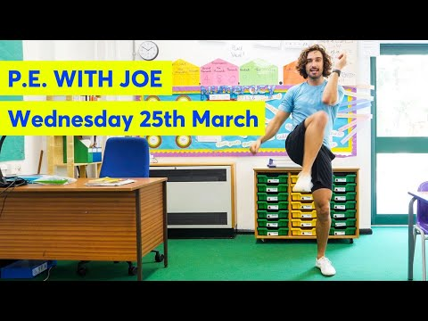
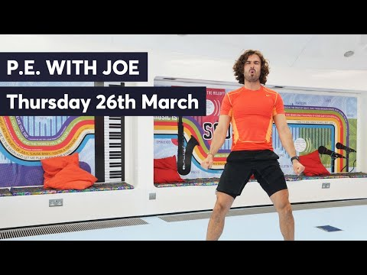
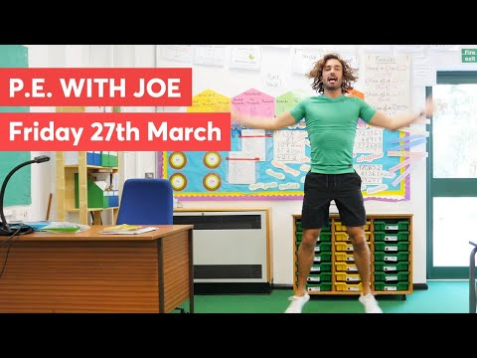




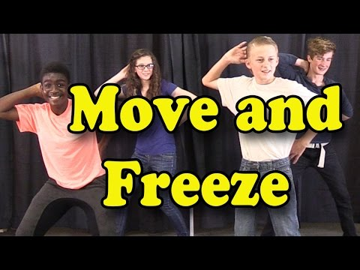





NETFLEX
Daily physical activity is very important to help keep a healthy mind and body during this difficult
time. Click on an image below to try a workout.
Healthy body = healthy mind
P.E. with Joe
Brain Breaks
Yoga

Slide 3
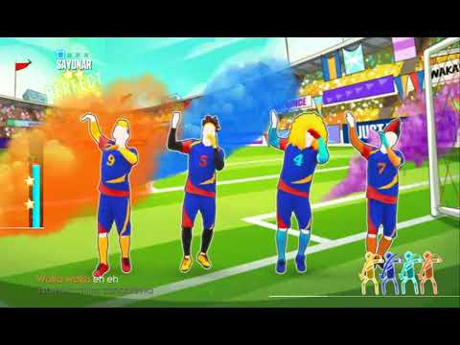
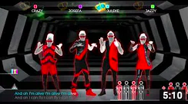


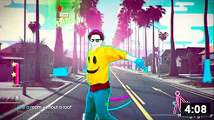
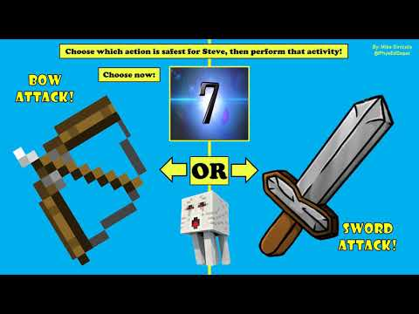
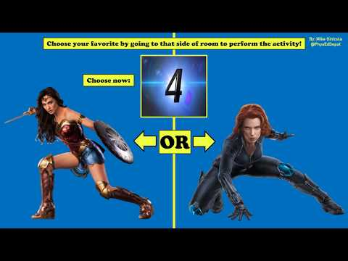
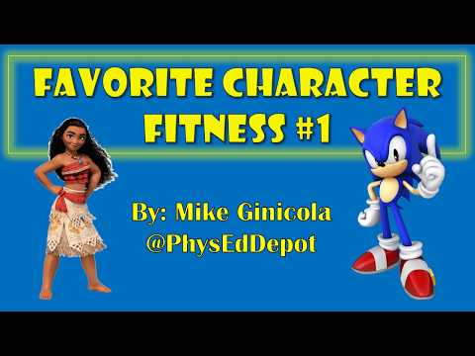
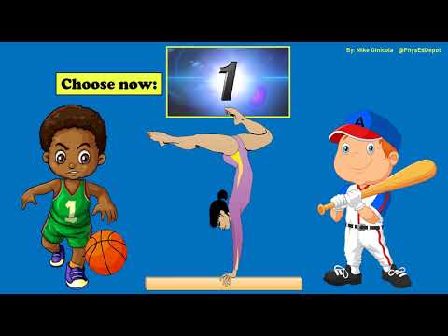
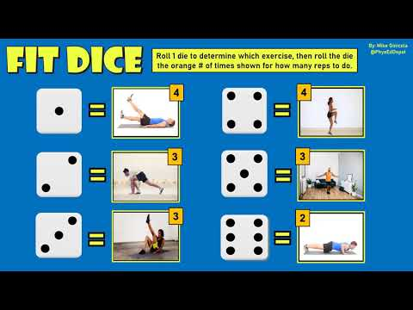





NETFLEX
Daily physical activity is very important to help keep a healthy mind and body during this difficult
time. Click on an image below to try a workout.
Healthy body = healthy mind
Just dance
Fitness fun
PE at home: challenge

Slide 4
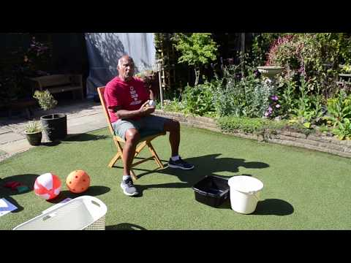
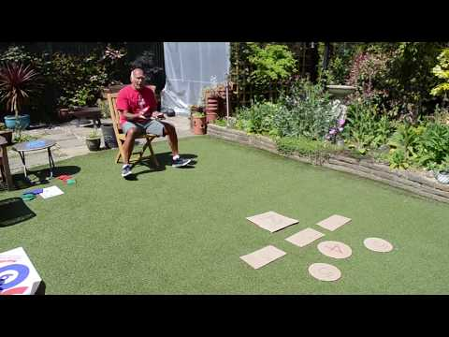
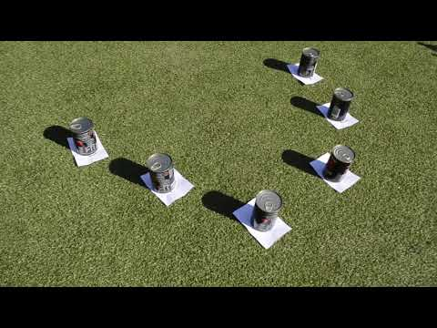
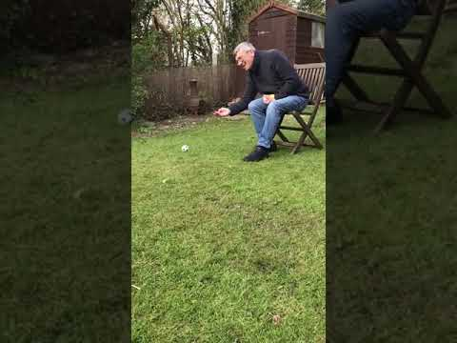
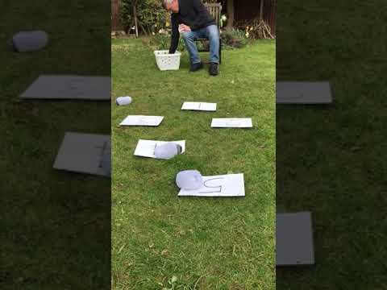
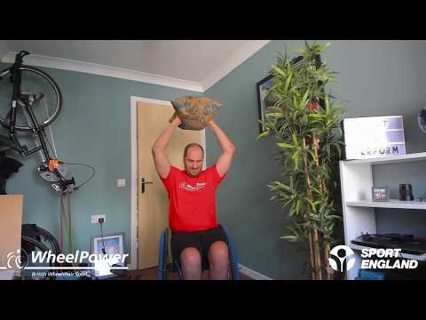
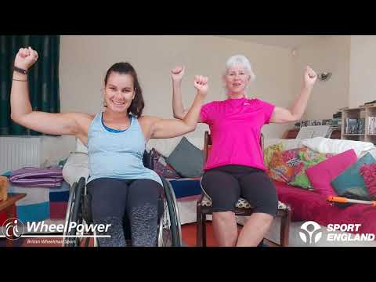
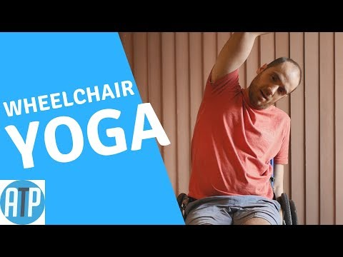
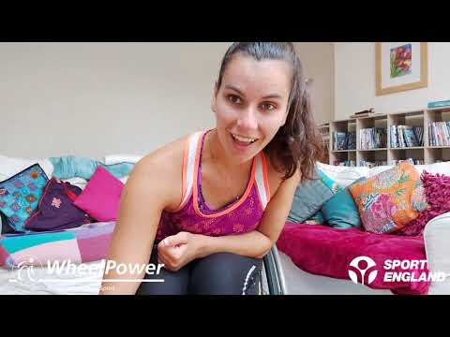
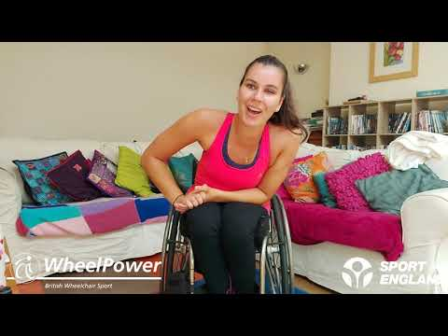
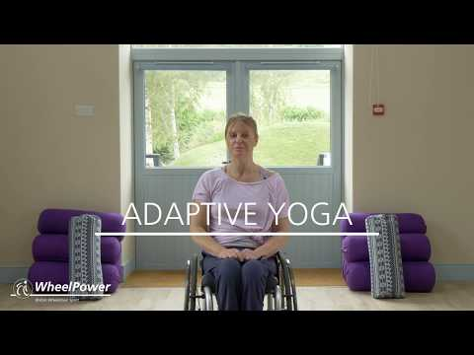
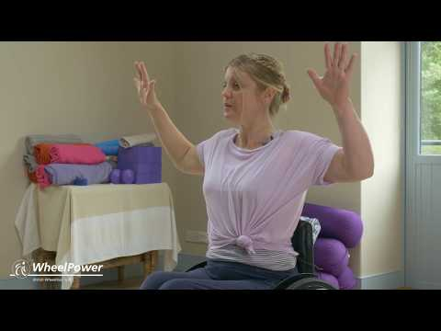
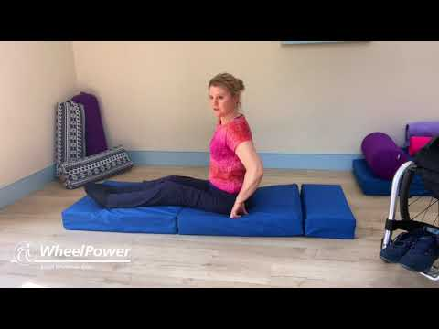
NETFLEX
Daily physical activity is very important to help keep a healthy mind and body during this difficult
time. Click on an image below to try a workout.
Healthy body = healthy mind
LRS Inclusive Activities
Audible Basketball
Target Bean Bags
Target Alley
Rolling Ball Challenge
Number Challenge
WheelPower Workouts
Simple Core Workout
Superhero Workout
Beginner Yoga
No Equipment Cardio
Circuit Training
Guess The Sport
Aeroplane Workout
Adapted Yoga 1
Adapted Yoga 2
Adapted Yoga 3

Slide 5
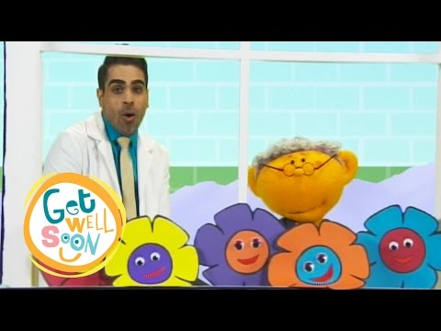




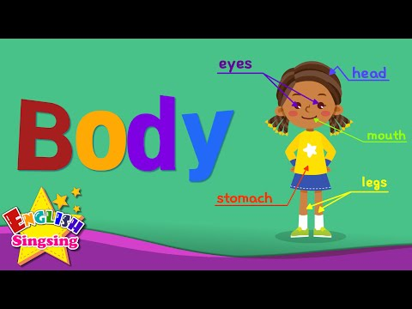
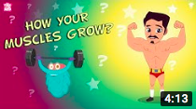
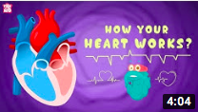

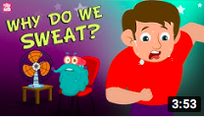
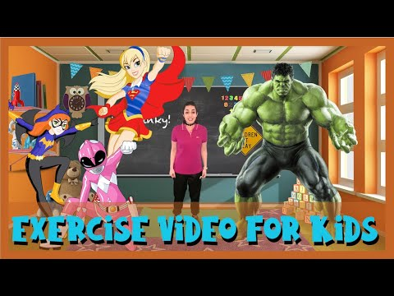




NETFLEX
Daily physical activity is very important to help keep a healthy mind and body during this difficult
time. Click on an image below to try a workout.
Healthy body = healthy mind
Healthy eating
Our bodies

Slide 6
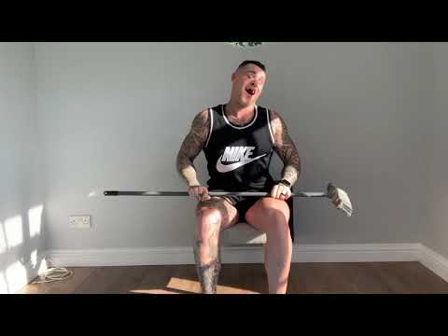
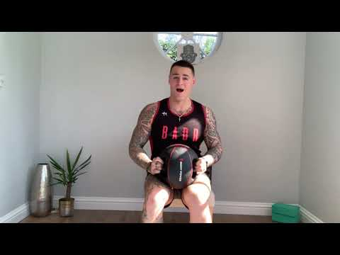
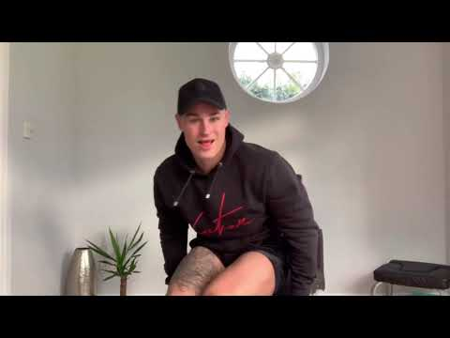
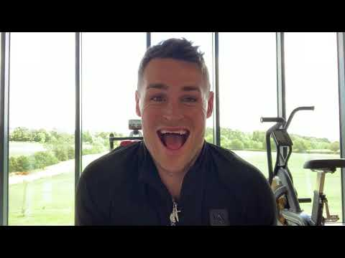
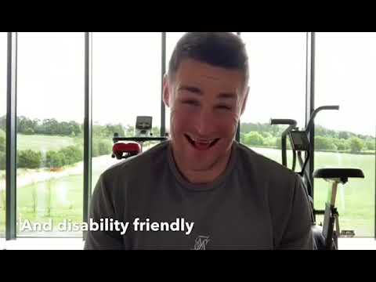
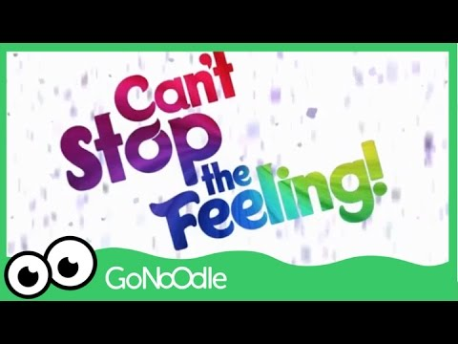









NETFLEX
Daily physical activity is very important to help keep a healthy mind and body during this difficult
time. Click on an image below to try a workout.
Healthy body = healthy mind
James Sutliffe Fitness
Wheelchair Cardio
Wheelchair Core
Upper-body Workout
Wheelchair HIIT
Wheelchair Workout
Dance

Slide 7










NETFLEX
Daily physical activity is very important to help keep a healthy mind and body during this difficult
time. Click on an image below to try a workout.
Healthy body = healthy mind
MATP
Striking and Kicking whilst lying
Striking with hands
Striking with a bat
Striking with Upper Body
Kicking whilst standing
Striking, Kicking and Dexterity
Mobility: Rolling
Mobility: Across the floor
Mobility: Stepping Up/Over
Mobility: Walking

Slide 8








NETFLEX
Daily physical activity is very important to help keep a healthy mind and body during this difficult
time. Click on an image below to try a workout.
Healthy body = healthy mind
Inclusive Sports at Home
BBS Tennis Workout #1
BBS Tennis Workout #2
100 Shot Rally Challenge
Throw and Catch #1
Volleyball
Throw and Catch #2
Wheelchair Dancing
Home Exercise Inspiration
VI Tennis Activity
Sitting Volleyball

