Slide 1
Little Wandle Letters and Sounds Revised
Parent meeting
Friday 30th September 2022

Slide 2
Why have we bought a new phonics scheme?
Government carried out a review of phonics provision in primary schools last year
Over 30 schemes were approved
A school’s phonics provision should be rigorous, systematic and used with fidelity
Progression should be systematic and consolidated through reading practice
A child should be able to read their reading book with 90% accuracy and fluency
Their reading book should not feature any unfamiliar sounds

Slide 3
Benefits of Little Wandle Letters and Sounds Revised
Modern, updated since original Letters and Sounds
Clear progression
Reading books
Lesson plans
Flashcards
Display resources
Assessment tools
1:1 support and ‘catch-up’ lessons

Slide 4
Terminology
Phoneme- the sound we hear
Grapheme- how a sound is written
Digraph- two letters that make one sound e.g. ai, oo, ee
Trigraph- three letters that make one sound- e.g. igh, air, ear
Tricky word- a word we cannot read or spell phonetically
Sound buttons- dots to show individual graphemes and dashes to show digraphs and trigraphs
Segmenting- breaking the word down into each individual sound
Blending- fluently joining together the phonemes to say a whole word

Slide 5
How the children are taught
Lesson structure-
        Revisit and review previously taught phonemes/graphemes, words and tricky words
        Teach and practise a new phonemes/graphemes
        Orally blend words with the new phonemes
        Teacher-led blending to read words with the new phonemes
        Learn to read a new tricky word (video on next page)
        Practise and apply the new phonemes/graphemes and tricky word by reading/writing a sentence, matching words to pictures

Slide 6
‘How to’ videos
https://www.littlewandlelettersandsounds.org.uk/resources/for-parents/
How to pronounce the graphemes
How ‘tricky words’ are taught

Slide 7
Reading practice
Learning at school and practising at home
Your child will bring home two books- a sharing book for pleasure and a reading practice book.
Reading Practice Book:
      Carefully matched to your child’s current reading level.
      It should be fairly easy
      Fluency and confidence
      Sounds, unfamiliar words and tricky words in book
      Help if there is a word they are stuck on
      Discuss the book after- prompt questions in back

Slide 8
Sharing book:
      Library book
      Lifelong readers
      Enjoy together
      Read it to or with your child
      Have fun! Discuss pictures and words, predict what might happen, use fun voices for characters, discuss fun facts, etc.
      You can also read anything else you have at home

Slide 9
How to help your child at home
Keep your reading practice at home short and fun
Encourage your child to read to different family members
If your child is reluctant to read, try reading a page each
Read a variety of texts- comics, recipes, shop signs, instructions, etc.
Children who read at home tend to make accelerated progress compared to those who do not read and gives them confidence in all subjects
Practise any specific sounds/words that your child has struggled with in their reading practice book
ebooks

Slide 10
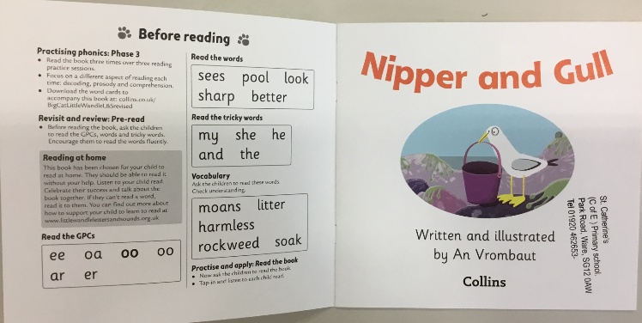

Slide 11
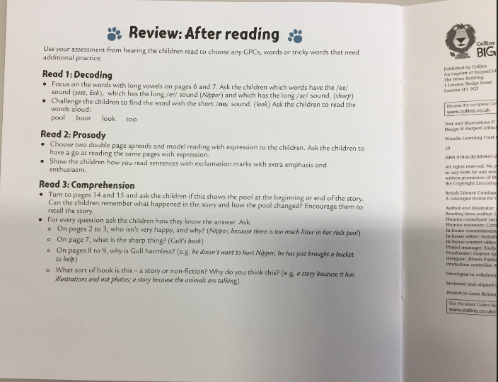

Slide 12
Are there any questions?

