Slide 1
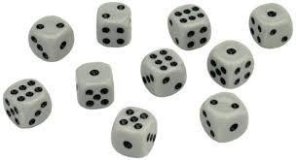
Dotzi
The aim of the game is get the dice showing the same number as quickly as possible.
Original game.
Each player holds ten dice in their hands. At ‘Go’, all players roll and decide which number they are going to go for. They put all dice showing that value to one side and roll the others, keep repeating until all dice show the same value.
You don’t have to wait for the other players to roll again – it is only the first roll which everyone has to roll together.
Variations.
Use 6 dice and collect all the numbers either randomly or in order
Collect pairs of numbers
Collect combinations, ie. pairs and trios or 5 of one type and 5 of other etc.

Slide 2
Card Game: Close call
Compliments to 100
The aim is get as close to 100 as possible – without going over.
Each player gets 6 cards.
Players select 4 cards from their hand, making each pair into a two digit number. The cards can be arranged in any order.
The winner is the person whose 2 two-digit numbers sum closest to 100 – without going over.
Notes:
Card game.
Need

Slide 3
High Roller
Aim: to end with the highest total.
Roll 3 dice, put the highest value die to the side
Roll the remaining 2 dice, again putting the highest value die to the side
Roll the remaining die.
Total of the 3 dice.

Slide 4
Make 21.
Roll 5 dice
Which of the the numbers from 1 to 21 can you make using the numbers shown?

Slide 5
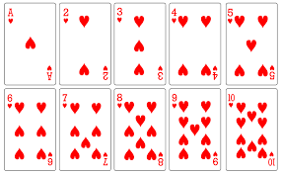
Tens Down
Tens Down – Card game rules
This card game helps pupils to rehearse the crucial number bonds to 10. It is similar to Tens Go Fish but with an added element of risk. Enjoy.
You will need:
Pack cards with picture cards and 10s taken out (or tens frame sets of cards).
Three or four players
Object of the game – win by being the first player to lose all their cards
Dealer deals 5 cards to each player and then lays the remaining cards face down in a pile
Players take it in turns to lay down pairs that make ten
If they don’t have a pair that make ten they can either
pick up 1 card from the pile in the middle or
ask another player for a card they need to complete a pair – BUT beware if the player hasn’t got the card, then they have to pick up 2 cards from the pile!
Players have to wait until the next go if they make a pair with a card from the pile or a pair
If asked players must give up a card when they have it
Once the card pile has finished players must shuffle the pairs of tens and turn them over to form a new pile.

Slide 6
Concentration - a game for 3 to 4 players
Resources:
6 pairs of tens frame cards that ‘make 10’, shuffled and face down on the table.
Rules:
Players take it in turns to turn over two cards. If the cards ‘make 10’ then they can keep them. If not they have to turn the cards back over. When all of the cards have been collected the player with the most cards is the winner.
Can be extended to other numbers

Slide 7
Don’t Make My Number
0 1 1 2 2 3 3 4 4 5 5 6 6 7 7 8 8 9 9
Rules:
Pairs take it in turns to place a number in the circle. But they must avoid numbers that would ‘make the given number e.g. 10’ e.g. if a pair has put 6 in the circle then the other pair must not put 4 in otherwise they make 10. A more difficult version is to never make the given number e.g. 10 with any combination of numbers e.g. if there is a 1, 3 and 5 in already the circle then the numbers 9, 7, 5, 2, 6 and 4 cannot be chosen. The pair who place the last number in the circle without making 10 are the winners.

Slide 8
Only Connect4 (game for 2 players)
Resources:
10 sided dice (1-10) or deck of tens frames cards
Rules:
1. Player 1 rolls the dice and doubles their roll.
2. They claim a number on the board with that answer to cover with a counter or colour in.
3. Player 2 rolls and claims a number to cover with a counter or colour in.
4. First player with 4 in a row wins.

Slide 9
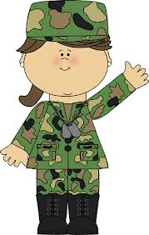
Fraction war
First Card
Highest fraction wins and captures the cards.
Winner is the person with the most cards after ______ rounds.
Adaption: use 4 cards to create 2 fractions to add together.
Second Card

