Slide 1
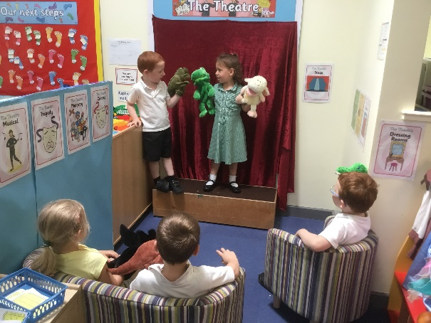
Personal, Social and Emotional Development
Extended Learning Opportunities and Early Years Outcomes in
Afternoon Nursery
Understanding the World
Remembering significant events in their own experiences
Recalling special times shared with family or friends
Selecting and using resources
Developing confidence in different social situations
Talking confidently to others while playing
Negotiating with other children
Activity:
Showtime!
Physical Development
Expressive Art and Design
Experiments with different ways of moving
Forming recognisable letters on tickets and posters
Using equipment safely
Acting out a narrative with other children
Exploring the sounds of different instruments
Building a repertoire of songs
Engaging in imaginative role play
Communication and Language
Understanding humour
Using talk to introduce a narrative or storyline in play
Using language to imagine and create roles and experiences
Using talk to pretend that objects stand for something else in play
Literacy
Mathematical Development
Giving meaning to marks when making tickets and posters
Recalling characters and events from familiar stories
Using repeated words and phrases from stories
Developing an awareness of story structures
Describing relative position on the stage
Sequencing familiar events
Writing numbers on tickets
Using language related to money when using the till

