Slide 1
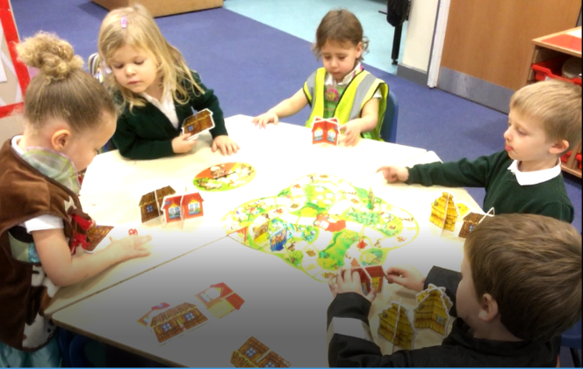
Personal, Social and Emotional Development
Extended Learning Opportunities and Early Years Outcomes in
Afternoon Nursery
Understanding the World
Talking about why things happen and how things work
Selecting resources
Taking turns and sharing resources
Demonstrating friendly behaviour
Activity:
Playing Board Games
Physical Development
Expressive Art and Design
Using a pincer grip to select cards / turn a spinner
Noticing what adults do, imitating what is observed and then doing it spontaneously
Communication and Language
Literacy
Responding to and following instructions
Using talk to explain what is happening and give explanations
Asking questions
Mathematical Development
Using number names spontaneously and accurately in play
Understanding that numbers identify how many objects are in a set
Completing games and puzzles that are linked to stories e.g. The Three Little Pigs

