Slide 1
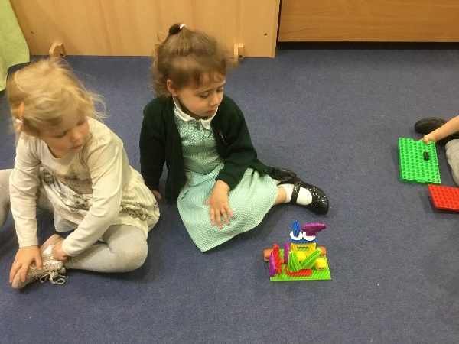
Personal, Social and Emotional Development
Extended Learning Opportunities and Early Years Outcomes in
Afternoon Nursery
Understanding the World
Talking about why things happen and how things work
Looking at similarities and differences
Noticing detailed features of objects
Selecting and using resources
Showing confidence in asking adults for help
Welcoming and valuing praise for achievements
Talking about our abilities
Activity:
Construction Challenge
Physical Development
Expressive Art and Design
Understanding that equipment has to be used safely
Handling construction materials with increasing control
Using various construction resources
Constructing with a purpose in mind
Joining construction pieces together to build, balance and create enclosed spaces
Communication and Language
Responding to and following instructions
Using talk to connect ideas and explain what is happening
Using talk to pretend that objects stand for something else in play
Literacy
Mathematical Development
Showing awareness of similarities of shapes in the environment
Showing interest in shapes by sustained construction activity
Talking about shapes or arrangements
Using shapes appropriately for tasks
Constructing with a purpose by linking challenges to a literacy theme, e.g. building a house for the Three Little Pigs

