Slide 1
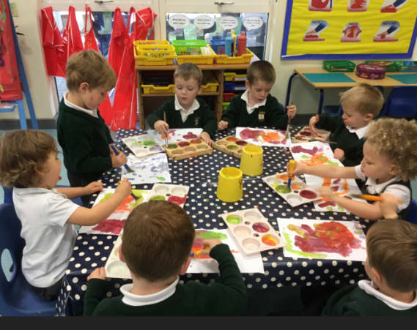
Personal, Social and Emotional Development
Extended Learning Opportunities and Early Years Outcomes in
Afternoon Nursery
Understanding the World
Talking about why things happen and how things work
Making observations and talking about changes
Selecting and using resources
Showing confidence in asking adults for help
Activity:
Exploring Colour Mixing
Physical Development
Expressive Art and Design
Developing control when using tools
Washing and dry hands independently
Realising that tools can be used for a purpose
Exploring colour and how colours can be changed
Experiments with marks
Communication and Language
Literacy
Responding to and following instructions
Understanding use of objects
Using talk to connect ideas and explain what is happening.
Mathematical Development
Using number names spontaneously and accurately in play
Giving meaning to marks as they paint
Colour mixing linked to themed stories e.g. Brown Bear, Brown Bear

